Slide 1
Resource Management in Distributed Systems
Task assignment,
Load-balancing and Load-sharing

Slide 2
Introduction
Distributed systems contain a set of resources interconnected by a network
Processes are migrated to fulfill their resource requirements
Resource manager are to control the assignment of resources to processes
Resources can be logical (shared file) or physical (CPU)
We consider a resource to be a processor

Slide 3
Types of process scheduling techniques
Task assignment approach
  User processes are collections of related tasks
  Tasks are scheduled to improve performance
Load-balancing approach
  Tasks are distributed among nodes so as to equalize the workload of nodes of the system
Load-sharing approach
  Simply attempts to avoid idle nodes while processes wait for being processed

Slide 4
Desirable features of a scheduling algorithm I.
No A Priori Knowledge about Processes
  User does not want to specify information about characteristic and requirements
Dynamic in nature
  Decision should be based on the changing load of nodes and not on fixed static policy
Quick decision-making capability
  Algorithm must make quick decision about the assignment of task to nodes of system

Slide 5
Desirable features of a scheduling algorithm II.
Balanced system performance and scheduling overhead
  Great amount of information gives more intelligent decision, but increases overhead
Stability
  Unstable when all processes are migrating without accomplishing any useful work
  It occurs when the nodes turn from lightly-loaded to heavily-loaded state and vice versa

Slide 6
Desirable features of a scheduling algorithm III.
Scalability
  A scheduling algorithm should be capable of handling small as well as large networks
Fault tolerance
  Should be capable of working after the crash of one or more nodes of the system
Fairness of Service
  More users initiating equivalent processes expect to receive the same quality of service

Slide 7
Task assignment approach
Main assumptions
  Processes have been split into tasks
  Computation requirement of tasks and speed of processors are known
  Cost of processing tasks on nodes are known
  Communication cost between every pair of tasks are known
  Resource requirements and available resources on node are known
  Reassignment of tasks are not possible

Slide 8
Task assignment approach
Basic idea: Finding an optimal assignment to achieve goals such as the following:
  Minimization of IPC costs
  Quick turnaround time of process
  High degree of parallelism
  Efficient utilization of resources

Slide 9
Load-balancing approach
A Taxonomy of Load-Balancing Algorithms
Load-balancing algorithms
Static
Dynamic
Deterministic
Probabilistic
Centralized
Distributed
Cooperative
Noncooperative

Slide 10
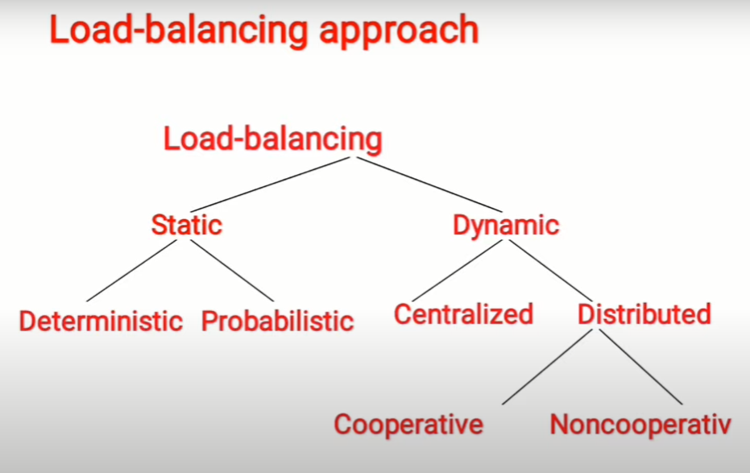

Slide 11
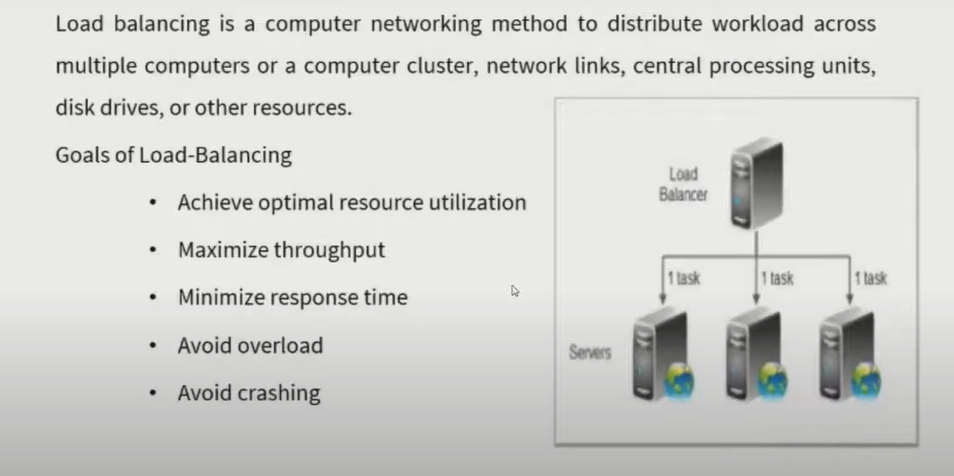

Slide 12
Load-balancing approach
Type of load-balancing algorithms
Static versus Dynamic
  Static algorithms use only information about the average behavior of the system
  Static algorithms ignore the current state or load of the nodes in the system
  Dynamic algorithms collect state information and react to system state if it changed
  Static algorithms are much more simpler
  Dynamic algorithms are able to give significantly better performance

Slide 13
Load-balancing approach
Type of static load-balancing algorithms
Deterministic versus Probabilistic
  Deterministic algorithms use the information about the properties of the nodes and the characteristic of processes to be scheduled
  Probabilistic algorithms use information of static attributes of the system (e.g. number of nodes, processing capability, topology) to formulate simple process placement rules
  Deterministic approach is difficult to optimize
  Probabilistic approach has poor performance

Slide 14
Load-balancing approach
Type of dynamic load-balancing algorithms
Centralized versus Distributed
  Centralized approach collects information to server node and makes assignment decision
  Distributed approach contains entities to make decisions on a predefined set of nodes
  Centralized algorithms can make efficient decisions, have lower fault-tolerance
  Distributed algorithms avoid the bottleneck of collecting state information and react faster

Slide 15
Load-balancing approach
Type of distributed load-balancing algorithms
Cooperative versus Noncooperative
  In Noncooperative algorithms entities act as autonomous ones and make scheduling decisions independently from other entities
  In Cooperative algorithms distributed entities cooperatewith each other
  Cooperative algorithms are more complex and involve larger overhead
  Stability of Cooperative algorithms are better

Slide 16
Issues in designing Load-balancing algorithms
Load estimation policy
  determines how to estimate the workload of a node
Process transfer policy
  determines whether to execute a process locally or remote
State information exchange policy
  determines how to exchange load information among nodes
Location policy
  determines to which node the transferable process should be sent
Priority assignment policy
  determines the priority of execution of local and remote processes
Migration limiting policy
  determines the total number of times a process can migrate

Slide 17
Load-sharing approach
Drawbacks of Load-balancing approach
  Load balancing technique with attempting equalizing the workload on all the nodes is not an appropriate object since big overhead is generated by gathering exact state information
  Load balancing is not achievable since number of processes in a node is always fluctuating and temporal unbalance among the nodes exists every moment
Basic ideas for Load-sharing approach
  It is necessary and sufficient to prevent nodes from being idle while some other nodes have more than two processes
  Load-sharing is much simpler than load-balancing since it only attempts to ensure that no node is idle when heavily node exists
  Priority assignment policy and migration limiting policy are the same as that for the load-balancing algorithms

